Slide 1
Mindfulness and Safety
Rhona Flin, ELSE Workshop 14 June 2023

Slide 2
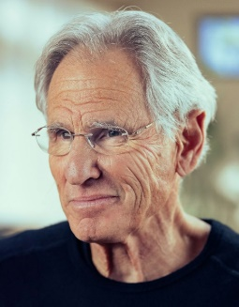
Mindfulness
Origins in religions e.g. Buddhism
‘self-regulation of one's attention and awareness of the present moment without evaluation and judgment’
(e.g. Jon Kabat-Zinn 2003,
Mindfulness Based Stress Reduction)

Slide 3
Mindfulness and Safety Leadership?
Supervisors/ Team Leaders at the worksite.
Managers
‘Mindful organizing’ (HRO) – team, organizational level

Slide 5
Mindfulness and Offshore Safety
Christiane Spitzmueller, UH & Peggy Linder, UH
Rhona Flin, RGU

Slide 6
Conceptual Model
Work situation awareness
Mindfulness
Safety culture and Safety behaviours
Safety
outcomes
Burnout & Well-being
Spitzmueller, Flin, Linder et al 2019

Slide 7
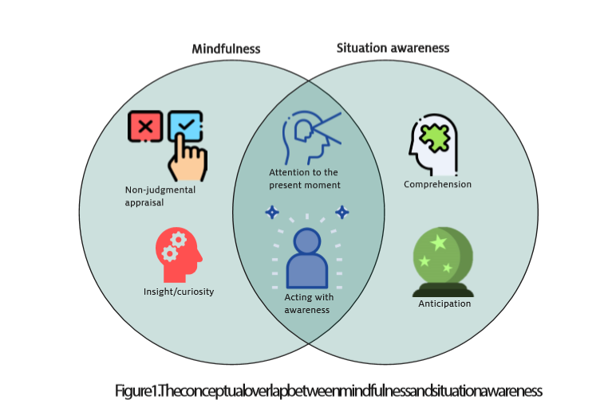
Mindfulness and Safety White Paper
University of Houston, 2020

Slide 8
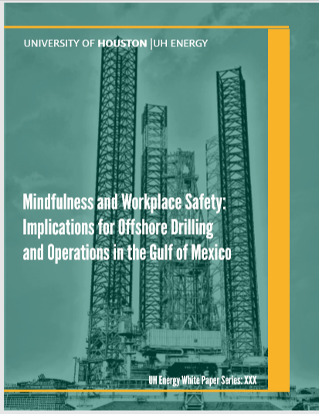
Spitzmueller, Flin, Lindaeur et al., 2020
https://uh.edu/uh-energy/research/nasem/white-paper-10232020.pdf

Slide 9
Mindfulness Training & Safety
17 studies e.g. Mindfulness Based Stress Reduction
(6 in health care/ social care occupations)
Typically 15-40 minute sessions
Practised daily for several weeks
Mainly positive results e.g. on rates of error, safety compliance, safety events (but few randomised control studies)

Slide 10
Evidence for links between
mindfulness trait and safety
and mindfulness training and safety
Journal of Organizational Behavior (2023)

Slide 11
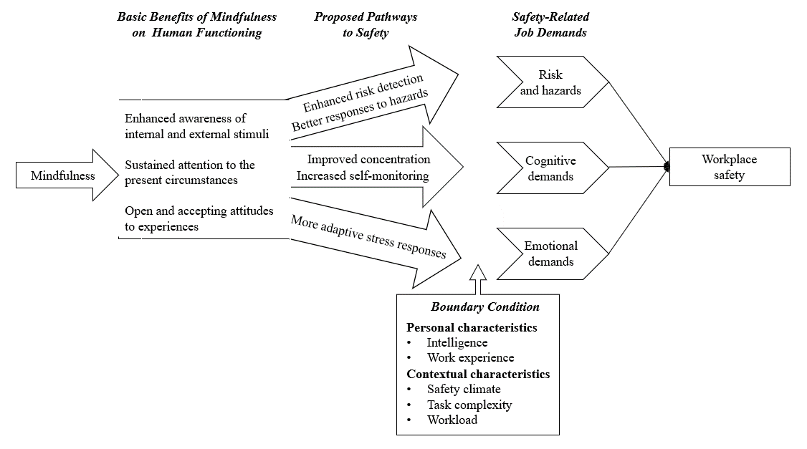
Mindfulness - safety link (Liu et al 2023)

Slide 12
Project Goals
How and why can mindfulness be used to enhance offshore safety culture?
How can we create and deploy offshore compatible mindfulness activities?
How can we measure mindfulness effectiveness offshore?
What are the best ways to disseminate mindfulness activities offshore?

Slide 13
The ‘Time 2 Refocus’ Program (2021)
2-minute mindfulness techniques, to enhance attentional performance, well-being & deal with daily hassles
University of Houston & Robert Gordon University
Notes:
This is where the Time 2 re-focus program comes in

Slide 14
Coaches guided workers through daily techniques.
Workers encouraged to use techniques each day during 30-day period.
Each week (4), workers learned a new technique.
100 offshore workers from two companies
Study conducted during pandemic

Slide 15
Multi-layered training rollout through respected offshore workers
1-time training
Daily practice for 30 days
1-time training
30 min mindfulness training
(HSE Staff training offshore workers)
2-min group practice before/during shift
(Coordinators training offshore workers)
90 min train-the-trainer program
(UH Team training HSE Staff)
2-min practice at suitable time during the high-risk period of their shift
(Offshore workers and offshore coordinators)
30-min train-the- coaches training
(HSE Staff training coordinators)

Slide 16
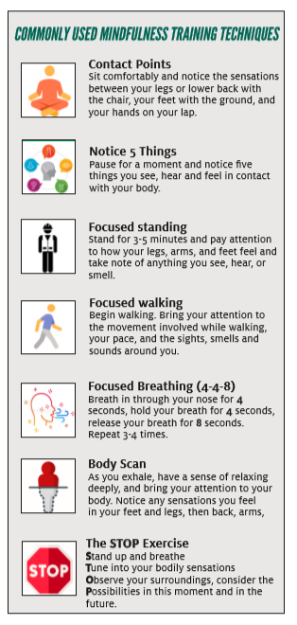
Mindfulness and Safety White Paper
University of Houston, 2020

Slide 19
Use of longitudinal and daily assessments
Survey | Timepoints for surveys
Online surveys | 1) Prior to the 30-minute group training
 | 2) Immediately following the 30-day mindfulness program
 | 3) 3 months following the 30-day mindfulness program
Daily, mobile app-delivered surveys | Once a day on each of the 30 days of the mindfulness program

Slide 20
Mindfulness/ Emotional Exhaustion, Fatigue & Strain
Individuals who practise more mindfulness have:
lower emotional exhaustion the same day
lower fatigue the same day
lower psychological strain the next day

Slide 21
Time and Situation Awareness
Towards the end of the study, individuals who practiced more had higher situation awareness the next day

Slide 22
Time and Job Satisfaction/ Productivity
Towards the end of the study, individuals who practised more had higher job satisfaction & higher sense of productivity the next day

Slide 23
Summary of results: Increased impacts towards the end
The results indicate that it takes time and practice for mindfulness interventions to show benefits.
Note: “Beginning” refers to the start of the 28-day mindfulness practice period and the “end” refers to the conclusion of the practice period, close to the 28th day.

Slide 24
Summary of results: Perceived helpfulness determines the impact of mindfulness
On days when workers engaged in more mindfulness practice, individuals who perceived mindfulness activities as more helpful had lower fatigue the next day.
Note: “More Helpful” perceived helpfulness of mindfulness are participants who view mindfulness as more helpful than the average participant. “Less Helpful” are participants who view mindfulness as less helpful than the average participant.

Slide 25
Mindfulness and safety study
Tailored mindfulness exercises, short and suitable for use at the worksite
Measured effects on worker well being, situation awareness and safety
Preliminary findings indicate that any benefits dependent on time and practice.
Possible paths - Attentional focussing? Wellbeing effects?

Slide 26
Mindfulness and Safety Leadership?
Selection - mindfulness trait?
Training – developing mindfulness skills (meditation)?
Organizational culture – mindful organizing?

