Slide 1
Towards an Attention-Based View of Systemic Crisis Ravi S. Kudesia, Temple University

Slide 2
Two Complimentary (But Orthogonal) Literatures
HRO: Ethnographies + well-regulated attention
Crisis: Case Studies + failures of attention (but…)

Slide 3
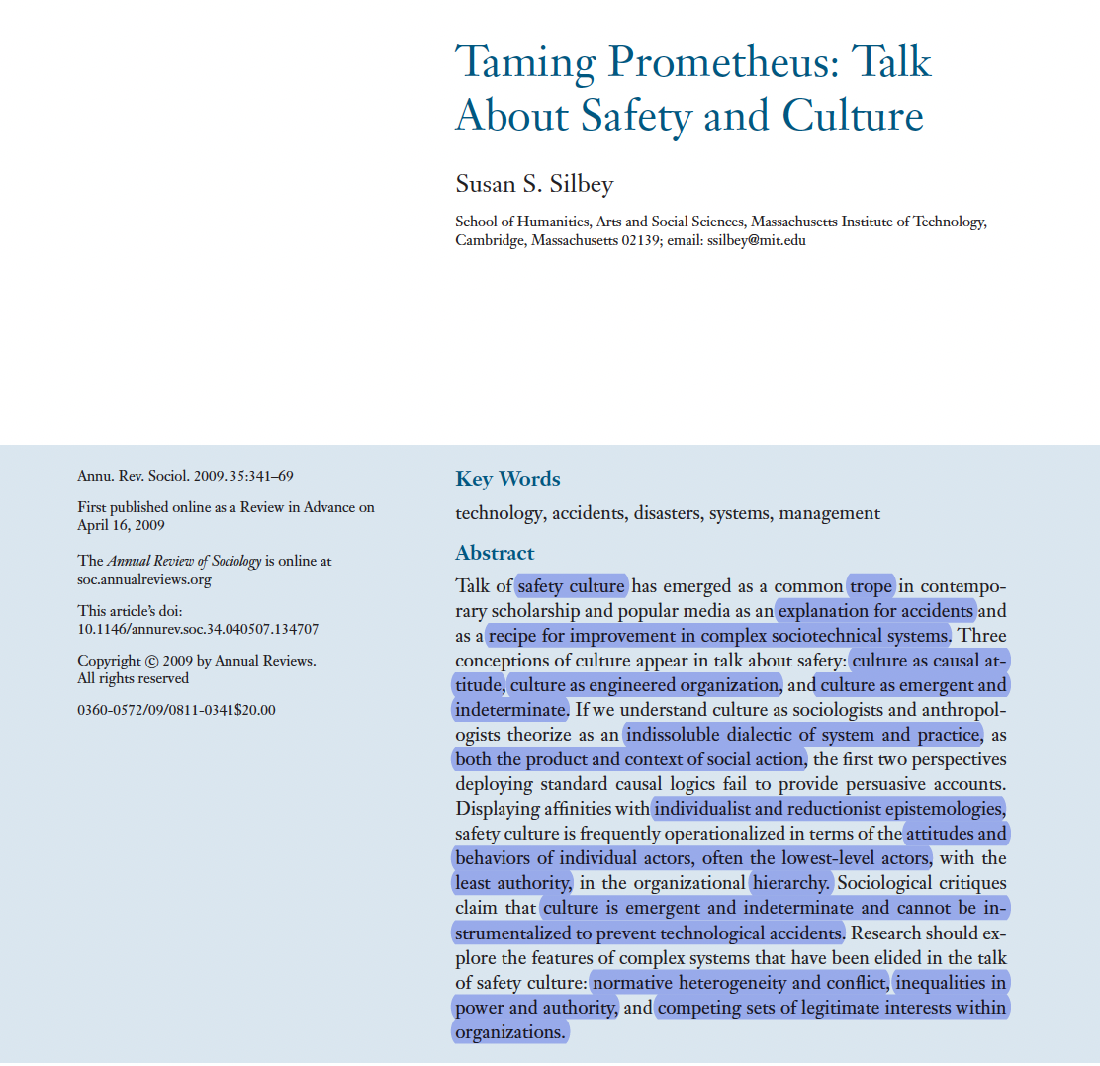

Slide 4
Attention-Based View
Organizations realize a complementarity between structure and attention

Slide 5
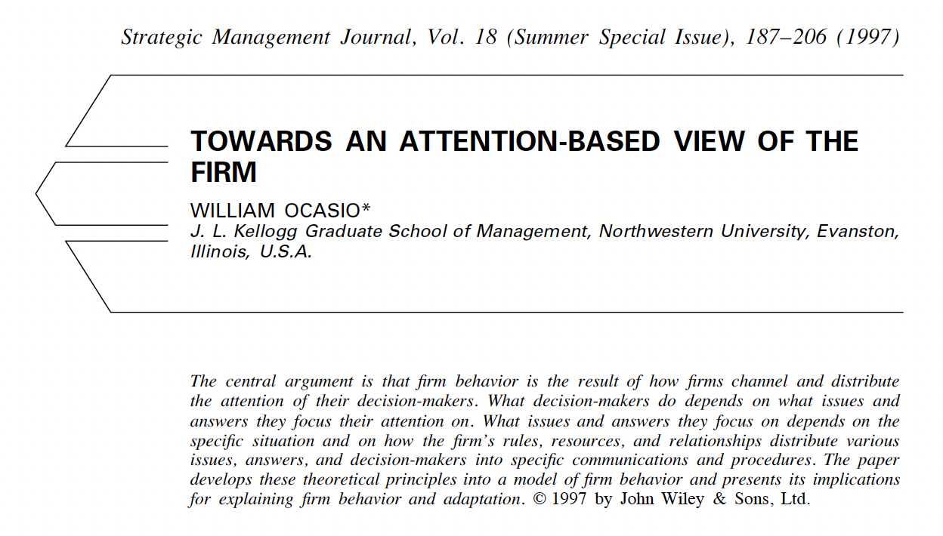

Slide 6
Attention-Based View
Organizations realize a complementarity between structure and attention
Look less and less like traditional big businesses: distributed, porous, systemic
Less emphasis on limited information processing capacity: more about quality
Less reliance on “pipes and prisms” of formal org. chart: dynamic conversations

Slide 7
Attention-Based View of Systemic Crises
Crises: rare + significant public events threaten negative impact on stakeholders (James et al. 2011)
Reveal failures in attention-shaping structures throughout system + attempts to repair them (Turner 1976)
Set of rich case studies to retheorize ABV: structure + systems → quality of attention
Practices: discover structure, identify system, identify mechanisms affecting attention quality

Slide 8
Method
Interpretive meta-synthesis of qualitative case studies (Hoon 2013; Saini & Shlonsky 2012)
12 org journals: excluding (a) quant, (b) figurative crises, (c) informal, (d) PR>conditions
Inductive coding 80 articles/42 crises: crisis type, non-organizational actors, narrative summary
Deductive coding: structuration theory → 22 conditions linking structure, systems, attention
Reconceptualization into new theoretical framework: ABV of systemic crises

Slide 10
Theoretical Framework: The ABV of Systemic Crises

Slide 11
Components of Structure
Modalities of Structure
Practices in System
Mechanisms
Quality of Attention
Frames
Identities
Resources
Roles
Routines
Rules
Technologies
Etc.
Interpretive
What do events mean?
Automating
Budgeting
Investigating
Operating
Planning
Regulating
Reporting
Etc.
Access to Information
Delegation of Responsibility
Distribution of Resources
Presence of Diverse Views
Prioritization of Issues
Reliance on Experience
Spread of Emotions
Etc.
Stability
Sustained focus on single issue
Legitimating
What should one do?
Vividness
Richly registering ongoing events
Resourcing
How can one get things done?
Coherence
Alignment of issues across actors

Slide 12
Components of Structure
Modalities of Structure
Practices in System
Mechanisms
Quality of Attention
Frames
Identities
Resources
Roles
Routines
Rules
Technologies
Etc.
Interpretive
What do events mean?
Automating
Budgeting
Investigating
Operating
Planning
Regulating
Reporting
Etc.
Access to Information
Delegation of Responsibility
Distribution of Resources
Presence of Diverse Views
Prioritization of Issues
Reliance on Experience
Spread of Emotions
Etc.
Stability
Sustained focus on single issue
Legitimating
What should one do?
Vividness
Richly registering ongoing events
Resourcing
How can one get things done?
Coherence
Alignment of issues across actors

Slide 13
Principle that patterns practices: provides generalizable basis for action, requires agency
Components of Structure
Modalities of Structure
Practices in System
Mechanisms
Quality of Attention
Frames
Identities
Resources
Roles
Routines
Rules
Technologies
Etc.
Interpretive
What do events mean?
Automating
Budgeting
Investigating
Operating
Planning
Regulating
Reporting
Etc.
Access to Information
Delegation of Responsibility
Distribution of Resources
Presence of Diverse Views
Prioritization of Issues
Reliance on Experience
Spread of Emotions
Etc.
Stability
Sustained focus on single issue
Legitimating
What should one do?
Vividness
Richly registering ongoing events
Resourcing
How can one get things done?
Coherence
Alignment of issues across actors

Slide 14
Structure is enacted within three different modalities: “answers” three questions
Components of Structure
Modalities of Structure
Practices in System
Mechanisms
Quality of Attention
Frames
Identities
Resources
Roles
Routines
Rules
Technologies
Etc.
Interpretive
What do events mean?
Automating
Budgeting
Investigating
Operating
Planning
Regulating
Reporting
Etc.
Access to Information
Delegation of Responsibility
Distribution of Resources
Presence of Diverse Views
Prioritization of Issues
Reliance on Experience
Spread of Emotions
Etc.
Stability
Sustained focus on single issue
Legitimating
What should one do?
Vividness
Richly registering ongoing events
Resourcing
How can one get things done?
Coherence
Alignment of issues across actors

Slide 15
e.g., how do operating practices draw on identities to legitimate attention to one issue over another?
Components of Structure
Modalities of Structure
Practices in System
Mechanisms
Quality of Attention
Frames
Identities
Resources
Roles
Routines
Rules
Technologies
Etc.
Interpretive
What do events mean?
Automating
Budgeting
Investigating
Operating
Planning
Regulating
Reporting
Etc.
Access to Information
Delegation of Responsibility
Distribution of Resources
Presence of Diverse Views
Prioritization of Issues
Reliance on Experience
Spread of Emotions
Etc.
Stability
Sustained focus on single issue
Legitimating
What should one do?
Vividness
Richly registering ongoing events
Resourcing
How can one get things done?
Coherence
Alignment of issues across actors

Slide 16
Systems: reproduced relations between actors, organized as social practices
Components of Structure
Modalities of Structure
Practices in System
Mechanisms
Quality of Attention
Frames
Identities
Resources
Roles
Routines
Rules
Technologies
Etc.
Interpretive
What do events mean?
Automating
Budgeting
Investigating
Operating
Planning
Regulating
Reporting
Etc.
Access to Information
Delegation of Responsibility
Distribution of Resources
Presence of Diverse Views
Prioritization of Issues
Reliance on Experience
Spread of Emotions
Etc.
Stability
Sustained focus on single issue
Legitimating
What should one do?
Vividness
Richly registering ongoing events
Resourcing
How can one get things done?
Coherence
Alignment of issues across actors

Slide 17
Start with a practice, see how it connects with other practices, what actors get involved (and when!) → extent of system
Components of Structure
Modalities of Structure
Practices in System
Mechanisms
Quality of Attention
Frames
Identities
Resources
Roles
Routines
Rules
Technologies
Etc.
Interpretive
What do events mean?
Automating
Budgeting
Investigating
Operating
Planning
Regulating
Reporting
Etc.
Access to Information
Delegation of Responsibility
Distribution of Resources
Presence of Diverse Views
Prioritization of Issues
Reliance on Experience
Spread of Emotions
Etc.
Stability
Sustained focus on single issue
Legitimating
What should one do?
Vividness
Richly registering ongoing events
Resourcing
How can one get things done?
Coherence
Alignment of issues across actors

Slide 18
e.g., Budgeting practices → compensation of actors w/ safety tasks → whether safety issues attended to during operations
Components of Structure
Modalities of Structure
Practices in System
Mechanisms
Quality of Attention
Frames
Identities
Resources
Roles
Routines
Rules
Technologies
Etc.
Interpretive
What do events mean?
Automating
Budgeting
Investigating
Operating
Planning
Regulating
Reporting
Etc.
Access to Information
Delegation of Responsibility
Distribution of Resources
Presence of Diverse Views
Prioritization of Issues
Reliance on Experience
Spread of Emotions
Etc.
Stability
Sustained focus on single issue
Legitimating
What should one do?
Vividness
Richly registering ongoing events
Resourcing
How can one get things done?
Coherence
Alignment of issues across actors

Slide 19
Attention: not stable, fixed limit in information processing, but shaped by concrete practices via mechanisms
Components of Structure
Modalities of Structure
Practices in System
Mechanisms
Quality of Attention
Frames
Identities
Resources
Roles
Routines
Rules
Technologies
Etc.
Interpretive
What do events mean?
Automating
Budgeting
Investigating
Operating
Planning
Regulating
Reporting
Etc.
Access to Information
Delegation of Responsibility
Distribution of Resources
Presence of Diverse Views
Prioritization of Issues
Reliance on Experience
Spread of Emotions
Etc.
Stability
Sustained focus on single issue
Legitimating
What should one do?
Vividness
Richly registering ongoing events
Resourcing
How can one get things done?
Coherence
Alignment of issues across actors

Slide 20
Attention has three qualities that may be differentially influenced by mechanisms
Components of Structure
Modalities of Structure
Practices in System
Mechanisms
Quality of Attention
Frames
Identities
Resources
Roles
Routines
Rules
Technologies
Etc.
Interpretive
What do events mean?
Automating
Budgeting
Investigating
Operating
Planning
Regulating
Reporting
Etc.
Access to Information
Delegation of Responsibility
Distribution of Resources
Presence of Diverse Views
Prioritization of Issues
Reliance on Experience
Spread of Emotions
Etc.
Stability
Sustained focus on single issue
Legitimating
What should one do?
Vividness
Richly registering ongoing events
Resourcing
How can one get things done?
Coherence
Alignment of issues across actors

Slide 21
e.g., planning practices → number of issues competing for attention → stability of attention to issue x?
Components of Structure
Modalities of Structure
Practices in System
Mechanisms
Quality of Attention
Frames
Identities
Resources
Roles
Routines
Rules
Technologies
Etc.
Interpretive
What do events mean?
Automating
Budgeting
Investigating
Operating
Planning
Regulating
Reporting
Etc.
Access to Information
Delegation of Responsibility
Distribution of Resources
Presence of Diverse Views
Prioritization of Issues
Reliance on Experience
Spread of Emotions
Etc.
Stability
Sustained focus on single issue
Legitimating
What should one do?
Vividness
Richly registering ongoing events
Resourcing
How can one get things done?
Coherence
Alignment of issues across actors

Slide 22
Components of Structure
Modalities of Structure
Practices in System
Mechanisms
Quality of Attention
Frames
Identities
Resources
Roles
Routines
Rules
Technologies
Etc.
Interpretive
What do events mean?
Automating
Budgeting
Investigating
Operating
Planning
Regulating
Reporting
Etc.
Access to Information
Delegation of Responsibility
Distribution of Resources
Presence of Diverse Views
Prioritization of Issues
Reliance on Experience
Spread of Emotions
Etc.
Stability
Sustained focus on single issue
Legitimating
What should one do?
Vividness
Richly registering ongoing events
Resourcing
How can one get things done?
Coherence
Alignment of issues across actors
Integrated model of structure, systems, and attention → Good for ABV in general, especially for crisis

Slide 23
How should we re-think crises using this framework?

Slide 24
Structure in the ABV of Systemic Crises

Slide 25
1. Structure Can Enable, Rather Than Constrain Attention
Structure (rules, resources, roles, etc.) are generalizable bases for action → applied to new situations
1988 Coal Mine fire: role of “buddy system” and evacuation
1977 Supper Club Fire: work roles (server areas) + gender roles (fire control)
Novelty in crises: mysterious individual inspiration vs. creative ways of instantiating general structures

Slide 26
2. Structure Must Be Instantiated in Action
Structure’s effects depend on concrete actions that instantiate it (not routines=mindless)
Practical Question: Allocating safety issues to a role → stabilize attention?
People w/ many roles: UK Soccer Industry (club managers) / NASA Challenger (“engineer hat”)
So, single dedicated role? 1994 Low’s Gully, 1992 Westray Mine, etc. → low coherence on issues
No broad theorizing! Structure doesn’t have a singular effect, embrace practical nuance

Slide 27
3. Structure is an Outcome of Agency
We tend to emphasize actors working within structure, not how actors shape structure
Barings Bank + Enron: secret accounts in margin files, special purpose entities, divisions
→ reduced coherence throughout organization → fraudulent activities
Organizational structure is not just about design, but also political

Slide 28
4. Structure is Enacted in Three Modalities
Any aspect of structure can be enacted toward different ends
Resource like expertise—not just about getting things done, but interpretation
1993 Novo Nordisk “world champion,” 1996 Mt. Everest “100% success rate”, Enron MBA hires as “best and brightest” → reduce vividness, emphasizing past success
Attunes us to unintended consequences

Slide 29
Systems in the ABV of Systemic Crises

Slide 30
1. Intertwined Practices Influence Each Other
To understand any practice, one must understand its intertwinement with others
1984 Challenger: 71% safety staff cut, C1-R/C1 designation, new vocabularies
Reveals hidden interdependencies, encourages configurational thinking

Slide 31
2. Practices Interface Beyond Organizational Boundaries
Effects of practices depend on factors that reach beyond the organization
Westray Mine: “tragic hero” schema of miners (memorials, black lung history, etc.)
Mount Everest: industry transition from elite mountaineering to adventure tourism
1979 Three Mile Island, 1986 Chernobyl, 2009 Sayano-Shushenskaya Dam: gov’t prioritize energy
2005 West Japan Railway: “safety” practices interfaced with cultural emotion schemas
Traces back to root causes outside organization, identifies external boundary conditions

Slide 32
3. Practices Involve Different Actors at Different Times
Temporality: how crises might be identified early by who? what new actors may emerge from the crisis? what actors are responsible for transforming structures in response to crisis?
Enron: stock analysts (“triple top” in August 2000) vs. media (legal drama in December 2001)
Public inquiries: production of “fantasy documents” to depoliticize crises?
Local stakeholders: United 93 on 9/11, protest in Ferguson, MO, Detroit’s bankruptcy
Broadens out set of actors we consider—and introduces a temporal element

Slide 33
4. Organizational Boundaries Become Flexible During Crisis
Crises reveal failures in organizational capacities, so practices that once helped can now hurt
Columbia recovery: NASA’s science, FEMA’s emergency responses, EPA’s hazardous materials
Local Stakeholders: KatrinaHelp Wiki, 2009 Black Sunday bushfire and resources, 2015 European refugee crisis emergent organizations to provide urgent needs
Understudied practices for interorganizational collaboration (including with emerging groups)

Slide 34
Attention in the ABV of Systemic Crises

Slide 35
1. Practices and Attentional Stability
Sustained focus on a single issue; repeated examinations to understand and respond to the issue
Key issue for stability: tradeoffs between safety issues and other issues
Allocating safety issues to roles, distributing resources, decision-making, oscillation, etc.

Slide 36
2. Practices and Attentional Vividness
Richness of registering ongoing events; integrating peripheral and even contradictory information
Key issue for vividness: accessibility and reliance on information/experience from past vs. present
Automation (Air France 447), reliance on expertise, repeated practices (condensate polishers! Air Florida Flight 90), availability of data (Lodgepole Well Blowout and Columbia disaster), etc.

Slide 37
3. Practices and Attentional Coherence
Extent to which actors distributed throughout the system align their attention to the same issues
Key issue for coherence: practices that enhance coherence can cause crises by reducing diversity of perspectives, yet increasing diverse perspectives can fragment coherence and thus exacerbate crises
Enron: job interviews, love bombing, rank and yank → coherence on vision, removal of dissent
Yet, diversity is not enough: 1993 FBI Waco standoff, 2008 Financial crisis and Federal Reserve
Potential solution: practices that go from mere presence of diverse perspectives to participation
What about public inquiries? UK soccer, Black Saturday bushfire, 1994 Ferry Estonia sinking, etc.

Slide 38
Final Thoughts
New way to think about structure, systems, and attention—all centered around practice!
Selection biases in drawing from management journals
(Happy to share my coding of crisis literature!)

Slide 39
Questions? Comments?

