Slide 1
Interlocking Surprises: Their Nature, Implications and Potential Responses Moshe Farjoun *
A presentation prepared for the
ELSE (European Leadership for Safety Education) Workshop
Graduate School of Economics and Management -EUR ELMI, Nice (France)
June 13-14, 2023
Please do not distribute or share in any form without the author's’ explicit permission
* Schulich School of Business, York University, Canada. mfarjoun@schulich.yorku.ca

Slide 2
I. Introducing Interlocking Surprises

Slide 3
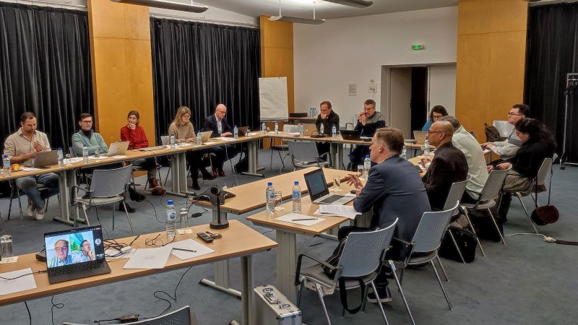
S
U
S R
S U R P R I S E S
R R
S U R P R I S E S
R S
S U R P R I S E S
S S
E
S
Strategy
Innovation & change
Organization
FonCSI, Paris
“The Ecology of Unexpected: Creative Destruction and The Smartphone Revolution Revisited”

Slide 4
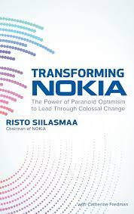
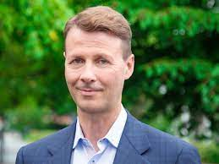
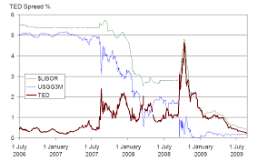
Risto Sillasmaa, former chairman of Nokia in his 2018 memoir. Discussing Nokia’s situation in 2012 – five years after the I-Phone’s introduction:
Can you relate?
“We all agreed that it was very, very important for us to think ahead, and not caught by surprise… We were all really tired of being surprised. We had been surprised by Apple, by Android, by Symbian [Nokia’s operating system] …by Microsoft – by so many things. We were just fed up with that”.

Slide 5
What have we seen so far?
Variety of surprises (for others- disruptions, innovations, discontinuities, shocks)
External and internal
Some are self inflicted
Intersecting with one another and situated in a broader competitive and dynamic context
Experienced as frequent and continuous by a focal organization, which unfortunately, was not well prepared
Have a cumulative effect, leading to a sense of exhaustion and frustration

Slide 6
“I have never seen such an accumulation of unexpected negative events – [a sharp] increase in interest rates, the collapse of the stock market and the IPOs of digital medicine, the Russia-Ukraine war, the collapse of SVB (Silicon Valley bank) and its domino effect in banking, the threat of political regime change in Israel, and more. The theories and methodologies that were written in the last decades are worthless in such a global environment of wholesale restructuring.” (The Marker, May 6, 2023).
Yonatan Adiri, CEO Healthy.Io
Test kits

Slide 7
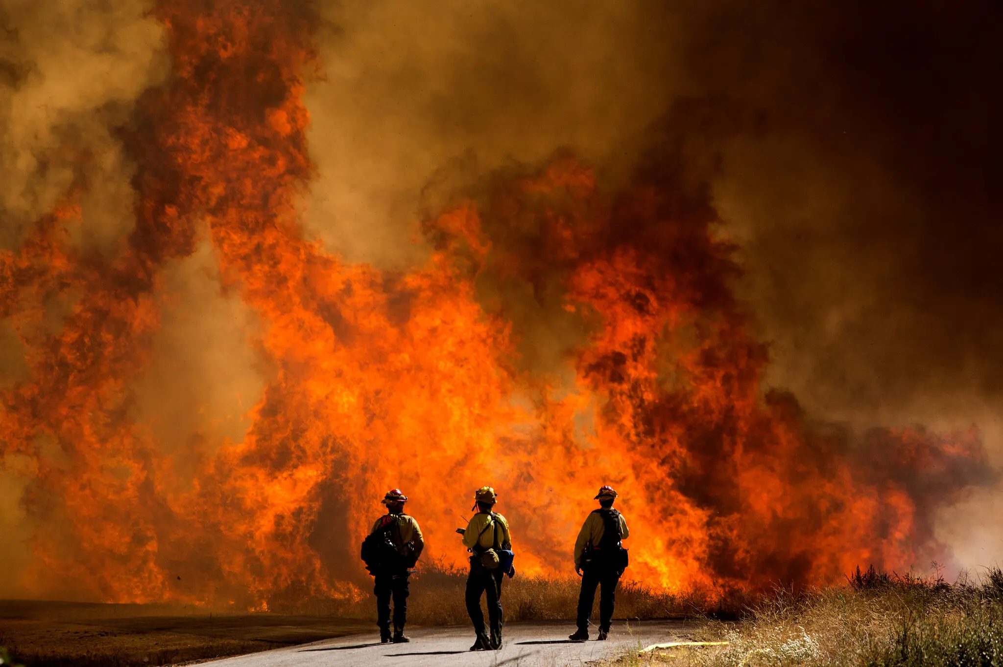
This is what living with climate change will look like: Not just an epic, Katrina- or Sandy-scale catastrophe every few years (though probably that, too), but a relentless grind of overlapping disasters, major and minor. The number of disasters that FEMA is handling is about twice what it was three years ago, before Hurricane Harvey struck Texas, and that doesn’t include its pandemic response. Disaster preparation and recovery have blurred into a single frenzied motion, never ending but also never quite succeeding (NYT, Aug 5, 2020).
California, Sept 2020
“We have been confronted with a series of crises, one more grave than the other,” President Macron said in a televised speech to the nation late last month. “The picture that I’m painting is one of the end of abundance,” he added. “We have reached a tipping point.” (NYT, Sept 6, 2022).
Paris, Sept 2022

Slide 8
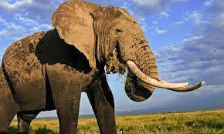
1. Experienced as real, and likely to remain and grow in frequency and importance
2. It rhymes with other phenomena such as perfect storms, disruptions and chain reactions, but features distinctive and novel elements
3. Does not get sufficient attention
4. Requires a different conceptualization and a better scrutiny of implications and responses

Slide 9
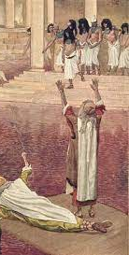
Practice and academia – different valuations
Novelty and/or usefulness to practitioners (i.e., how they think or act to reduce the likelihood and severity of risk)?
Yes
No
My hope is that through our dialogue these issues will be better clarified
Novelty/usefulness to academics?
Novelty/usefulness to academics?
Yes
No
Yes
No
1
2
3
4

Slide 10
Surprise

Slide 11
Surprises
Although they are often described in terms such as crises, disruptions, innovations, discontinuities and the like, the prior anecdotes refer to surprises, in one way or another
The unexpected (and even unthought of)
!?
The expected
Happens
Does not happen (e.g., a learned response fails)
!?

Slide 12
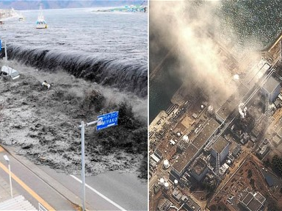
Interlocking surprises:
March 2011: Tsunami>>Earthquake:>>Crisis at Japan’s Fukushima nuclear plant>>Economic meltdown>>…..cover up on radiation levels as to not interfere with 2020 Olympics.
“This scenario did not appear in any of our drills”
Consistent with contemporary views on ecological surprises, the umbrella concept of interlocking surprises describes, and helps explain, how surprises evolve, circulate and compound in an ecology of action

Slide 13
Interlocking Surprises Defined
!?
!?
!?
Unexpected and significant developments that are interlinked:
in space (e.g., across several industries, nations, geographies, fields, or spheres of life such as political and economic),
in time (e.g., one surprise overlays or leads to another, or to a few of those)
or in scale or level (e.g., a surprise external to an actor leads to a surprising self- discovery, or a local surprise constitutes a microcosm of a broader systemic failure).
!?

Slide 14
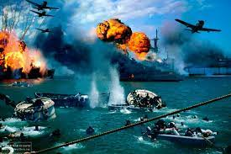
Interlocking Surprises: A new ontology- processual and relational
Surprise as a development rather than a discrete episode or a reaction with a clear beginning and end.
Features a cumulative event chain. Events and developments may occur or incubate prior to the onset of the surprise, and through and after it (e.g., adaptive surprises)
Surprise as relational – multi directional and ecological - rather than linear (stimulus-response). A struggle.
There is no dull moment…
Pearl Harbor
Dewey’s barking dog example
Time

Slide 15
How do surprises become interlocked? Enabling dynamics
Accelerated change
Multilateral competition and conflict
Complex yet fallible products and platforms (e.g., smart cities, the Internet of things, and autonomous cars)
Rapid-onset climatic events
Digital convergence
The blurring boundaries of industries and fields.
These factors normalize surprise but also make their interlocking more likely

Slide 16
How do surprises become interlocked?
Key sources:
A common factor (e.g., destruction of wildlife leading to both climate change and a faster spread of diseases and pandemics, a single technology posing different risk types)
A random event connecting two or more developments. Co-occurrence.
A coordinated and deliberate action by an agent or a group pf agents (such as different thrusts in a rival’s strategy or an enemy’s attack).
The entanglement of surprises suggests that it may be best to view them as root less (or a least radiating from multiple hubs)
Causes such as climate change and pandemics or digitization may be more significant than others but the idea of a single, strategic, root cause becomes more elusive.

Slide 17
How do surprises become interlocked?
Due to its emergent and combinatorial nature, the intersection of different developments can itself be surprising:
AI
AI generated fake news
Fake news
AI enhanced phishing attacks
Detection
Spreading fake news about cyber attacks
Cyber

Slide 18
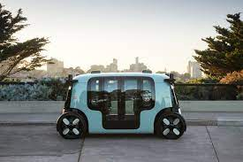
How interlocking surprises are experienced?
Can affect a single organization or a network of organizations.
Depending on their position, different participants experience these developments as challenges, opportunities, or threats, as innovations or as surprises. For instance, previously disrupting taxicabs, Uber is being disrupted by robot-taxies.
More generally, the more an agent is at the bottom of the pecking order, e.g., a small supplier to Amazon, and the less power it has to shape its environment, the more vulnerable it is to interlocking surprises.

Slide 19
II. Implications

Slide 20
Interlocking surprises: A timely concept
The concept extends other more familiar dimensions of turbulent environments such as speed and amplitude of change, uncertainty, and non-linearity
But differs from standard accounts of change as either being gradual or as featuring a punctuated equilibrium
As well, it highlight complexity, not only change
Intersections are significant in that unlike managers who experience them as a unified whole, academics tend to study key developments and “grand challenges” - such as fake news, generative AI, and Covid-19-, as standalone phenomena.

Slide 21
Interlocking surprises heighten several distinctive and interrelated considerations*:
1.Operating at or beyond limits
7.Resource decay and organizational fatigue
2.Complicated resource allocation
Interlocking Surprises
6.Shifts in boundaries and charters
3.Strained attention distribution
5.Incomplete learning cycles
4.Ineffective or narrow response repertoires
* Above those associated with “simpler” surprises

Slide 22
1.Operating at or beyond limits
* Over capacity
*“Compounded extremes”
* A potential tipping point
Interlocking Surprises

Slide 23
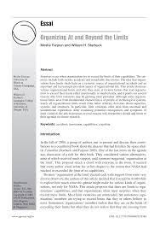
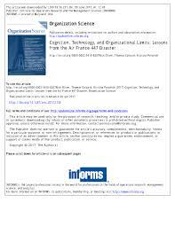
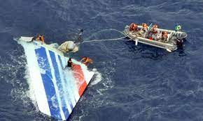
Operating at or beyond limits
NASA, Farjoun & Starbuck, 2007
“When an organization exceeds its limits, whether intentionally or unintentionally, even talented, and intelligent people with plentiful resources and laudable goals can find themselves incompetent to deal with their challenges.
Risks escalate, problems emerge, errors occur, errors are more likely to go undetected and uncorrected, solutions lag or lose their effectiveness, and threats become more ominous.
Such consequences may be subtle — inefficiency, deviations from expected performance, unethical acts such as fraud, or employee burnout.
Organizations may promise too much and overstep their capabilities, not so much as a result of conscious design but as responses to cumulative flows of events or as unintended by-products of decisions and actions.”
Air France 447, Oliver et al. 2017)

Slide 24
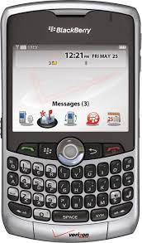
2.Complicated resource allocation
*Balancing short term and long term
*Fighting yesterday’s wars *Deploying reserves
*Errors of omission and commission
Interlocking Surprises

Slide 25
3.Strained attention distribution
Interlocking Surprises
*Parallel rather than serial processing
*No central entity to sense, evaluate or respond
*Both external and
internal surprises

Slide 26
4.Ineffective or narrow response repertoires
Interlocking Surprises
*Dealing with adaptive surprises as well as with new surprise types
*Nonlinear effects
*Unanticipated outcomes

Slide 27
5.Incomplete learning cycles
Interlocking Surprises
*Inadequate assimilation time
*Patching and
outdating of rules and practices

Slide 28
6.Shifts in boundaries and charters
Interlocking Surprises
*Established jurisdictions are being flexed
*New inter-organizational connections are revealed

Slide 29
7.Resource decay and organizational fatigue
*Burnout, fatigue eroding trust
*Fewer degrees of freedom
*Starting with a deficit
Interlocking Surprises

Slide 30
III. Potential Responses
The phenomenon of interlocking surprises highlights the need for adaptive responses, innovative solutions, and holistic approaches to navigate and thrive in a rapidly changing world.

Slide 31
Potential Responses
A full proof robust system is an ideal rather than a real possibility
Awareness of the nature and potential implications of interlocking surprises is a step in the right direction
Other, potentially effective, responses are offered next:

Slide 32
Two broad and complementary strategies for mitigating the potentially negative effects of interlocking surprises
Building Requisite Variety
Adopting “Smart” Solutions
Anticipation, mapping, sensing
Structural solutions
Resources, skills and capabilities
Dual (external/internal) orientation
Robust responses
Breaking affinities
Innovation and experimentation

Slide 33
Building Requisite Variety

Slide 34
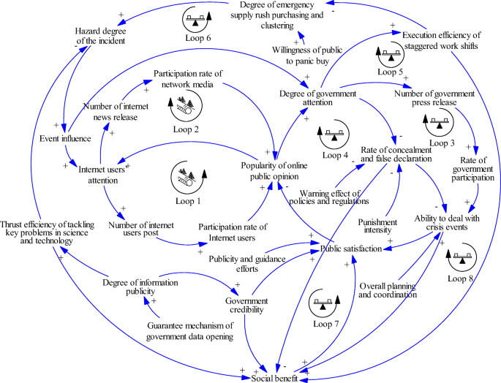
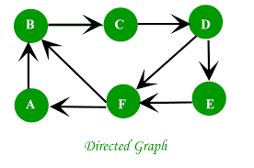
1.Anticipation, mapping, sensing
Scenario construction
System dynamics
Graph theory
Vulnerability to Covid
I
II
Vulnerability
to cyber
III
IV
Live documents

Slide 35
“It turned out to be a biological virus, which didn’t mostly kill people but kept them home. It could have been an internet virus which shut down our routers, and Disney, with theme parks, would be fine.”
Reed Hastings, Netflix’s CEO, Sept 2020

Slide 36
From a single surprise or challenge to multiple ones
Vulnerability to Covid-19
High
Disney’s theme parks
Interlocking surprises
Vulnerability to computer virus
Low
High
Netflix, Zoom
Low

Slide 37
Overlapping surprises, existential threats, temporality, and mitigation *
Panel A: Generative AI’s effects precede those of climate change
Climate change
Humanity survives
Humanity is devastated
Generative AI
Humanity survives
Humanity is devastated
* The scenarios and dates are hypothetical and serve to illustrate the importance of ordering effects and prioritizing.
2028
2035
Panel B: Climate change effects precede those of Generative AI
Generative AI
Humanity survives
Humanity is devastated
Climate change
Humanity survives
Humanity is devastated
2028
2035

Slide 38
2.Structural solutions
Internal overlap
Organized contestation/skepticism
Unorthodox alliances

Slide 39
3.Resources, skills and capabilities
Broader menu
Resource mobilization, repurposing, recombination
Watch for deskilling and resource atrophy

Slide 40
4. Dual (external/internal) orientations
Self discovery
Being attuned to internal and potentially more insidious developments
Honest audits
Periodical house cleaning of rules

Slide 41
Adopting “smart” solutions

Slide 42
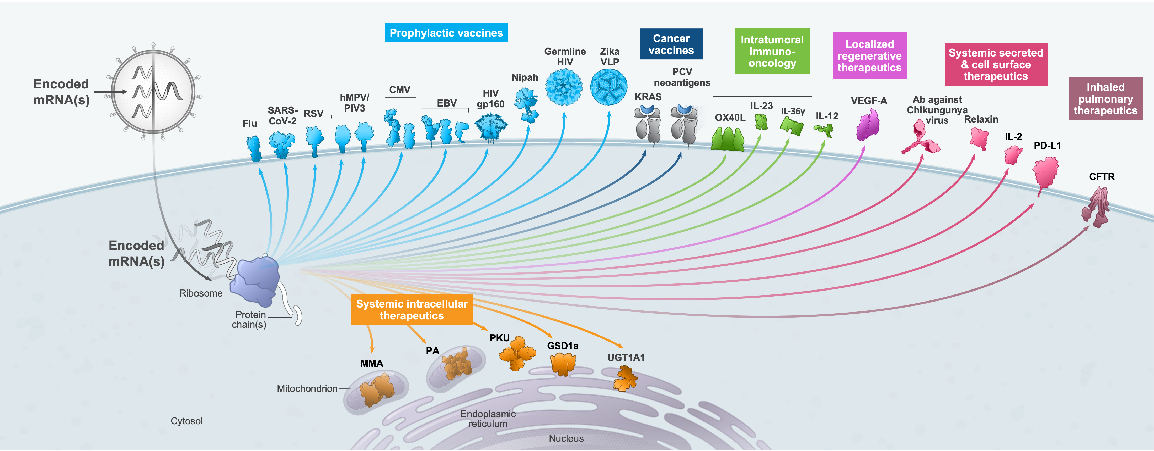
a. “Robust” responses
Not the best design under all circumstances but improved solutions overall
“No regret” moves – versatile across challenges and uncertainties
Generalized capabilities
Robust actions- good for both short term and long term
Sand sledding
Emirates Airlines
Moderna’s mRNA technology

Slide 43
b. Breaking Affinities
Decoupling: means from ends, products from resources, etc.
Reshuffling
Considering substitutes (e.g., trust and rules)
Rethinking the safety function (e.g., as benefiting from or contributing to other seemingly unrelated functions)

Slide 44
c. Mitigating surprises through innovation and experimentation (1)
Not all surprises are negative
Consider the complementarity of reliability and innovation (e.g., as forms of discontinuities)
Covid 19 accelerating innovation.
Dual roles at DARPA
Creativity and imagination are not only servicing innovation-centered organizations.
They are decisive in anticipating, preempting and responding to surprises
For instance, identifying unimagined combinations (e.g., using ChatGPT).
Delayed discovery

Slide 45
c. Mitigating surprises through innovation and experimentation (2)
Innovations can help combat threats ( e.g., IBM’s “accelerated discovery”)
Intelligent experimentation
"The best way to predict the future is to create it" (Abraham Lincoln)
Alternatively, one needs to be quick in identifying and assimilating new, cutting-edge technologies and solutions

Slide 46
IV. Summary and contributions

Slide 47
Key Contributions: the phenomenon
Shedding light on the significant, yet often misunderstood, and increasingly prevalent phenomenon of interlocking surprises.
Providing a framework aimed at enhancing our understanding of the nature of interlocking surprises, including their primary sources and the ways in which they emerge and manifest.
Exploring the theoretical and practical implications associated with interlocking surprises and identifying potential strategies for recipient organizations to mitigate the likelihood and severity of adverse outcomes.

Slide 48
Key Contributions: the phenomenon
While the specific manifestations of interlocking surprises may vary, their enduring presence is undeniable.
The increasing interconnectivity among humans and devices, coupled with the tighter integration of humans with their natural environment, will provide further opportunities to employ the concept of interlocking surprises as:
A descriptive term,
An explanatory tool, and
A boundary object for communities of practice.
Treating surprise as an isolated, linear phenomenon may no longer suffice.

Slide 49
Key Contributions: a newly proposed concept of surprise
Draws upon a relational process worldview
Promotes a more ‘macro’, ecological and diachronic understanding of surprise, forging stronger connections with innovation and discontinuities, and exploring their potential to offer counter-measures.
A wider lens on what individuals experience momentarily
Surprises not only interlock but also possess surprising interlocking aspects of their own.

Slide 50
Key Contributions: Turbulent environments
Transcending conventional markers of contemporary turbulent environments, such as uncertainty.
Emphasizing both the perpetual nature of change and complexity.
Offering an alternative perspective on change, one that is more layered, sedimented, and dialectical, in contrast to established views such as punctuated equilibrium.
Focusing discussion on global challenges and other significant developments as interrelated rather than standalone phenomena.

Slide 51
Key Contributions: Can we do better?
While dealing with interlocking surprises may appear daunting at first glance, it is not necessarily an insurmountable challenge.
The modest suggestions put forth herein aim to inspire organizations and individuals to develop even more effective responses as they learn to navigate and cope with this more intricate form of surprises.

Slide 52
Thank you !

