Slide 1
How to balance safety, autonomy, and uncertainty
Gudela Grote
Professor of Work and Organizational Psychology
ETH Zürich

Slide 2
Overview of talk
Tensions between safety and autonomy
Mechanisms for loose coupling
The role of uncertainty
Implications for leaders/leadership

Slide 3
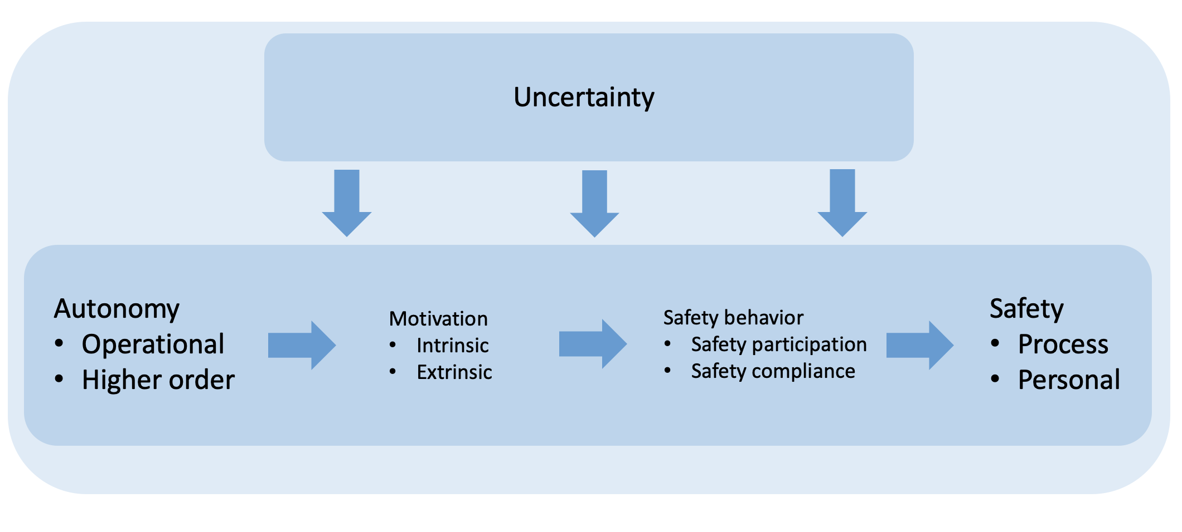
Tensions between safety and autonomy in risk management (Grote, 2020)
Safety requires control which is easiest to establish by centrally prescribed action in stable situations.
High-risk operations by definition imply limited predictability and require flexible local action.
As a consequence, risk management is riddled with concurrent demands on stability and flexibility.
Autonomy as the presumed enemy of safety is essential for worker motivation and handling uncertainty.
Safety comes in two types: process versus personal; Autonomy also comes in two types: operational versus higher order.
Safety and autonomy types need to be matched, thereby bridging system-level and individual-level approaches to risk management.

Slide 4
Loose coupling as a way to bridge safety-automony tensions (Weick, 1976; Orton & Weick, 1990)
"Organizations and their subunits can act on both a technical level, which is closed to outside forces (coupling produces stability), and an institutional level, which is open to outside forces (looseness produces flexibility). This general image is described as the dialectical interpretation of loose coupling."
Organizations can thus concurrently enact stability/centralization and flexibility/decentralization.
Not to be confused with Perrow's (1984) definition of coupling as a single dimension ranging from loose to tight coupling based on the amount of slack in work processes.

Slide 5
Some mechanisms for establishing loose coupling: Rule management
Mechanism 1. Worker participation in rule making.
Participation in rule making creates higher order autonomy, which increases process safety by helping workers to combine rote rule following and proactive rule adaptation in the face of uncertainty; and increases personal safety by raising intrinsic motivation.
Mechanism 2. Flexible rules.
Flexible rules offer operational autonomy by describing processes for problem solving rather than solutions and by setting boundaries for action rather than prescribing action. Thereby, personal and process safety are increased because mindful routines are established where rules concurrently operate as constraints and enablers of action.

Slide 6
Some mechanisms for establishing loose coupling: Leadership
Mechanism 3. Giving workers a sense of purpose through transformational leadership.
Transformational leaders give workers a sense of purpose by providing them with a vision for their work and empowering them to enact that vision. Thereby, leaders foster intrinsic motivation for tasks and behaviors that are not inherently motivating, such as safety compliance in relation to personal safety.
Mechanism 4. Paradox-savvy leadership.
Leaders who explicitly acknowledge the duality of stability and flexibility as a fundamental organizational paradox are more capable of managing the dynamic delegation of operational autonomy required for process safety.
Mechanism 5. Sensemaking.
Leadership grounded in sensemaking can raise awareness for stability and flexibility demands in work teams and initiate the swift switches between central control and local autonomy needed for personal and process safety.

Slide 7
Some mechanisms for establishing loose coupling: Climate / Culture
Mechanism 6. Shared perception of safety management (=safety climate).
Safety climate increases personal safety by creating intrinsic motivation through shared commitment to safety, which compensates for low operational autonomy.
Mechanism 7. Shared basic assumptions that promote safety (=safety culture).
Safety culture increases process safety by bounding operational autonomy through centralized norms.

Slide 8
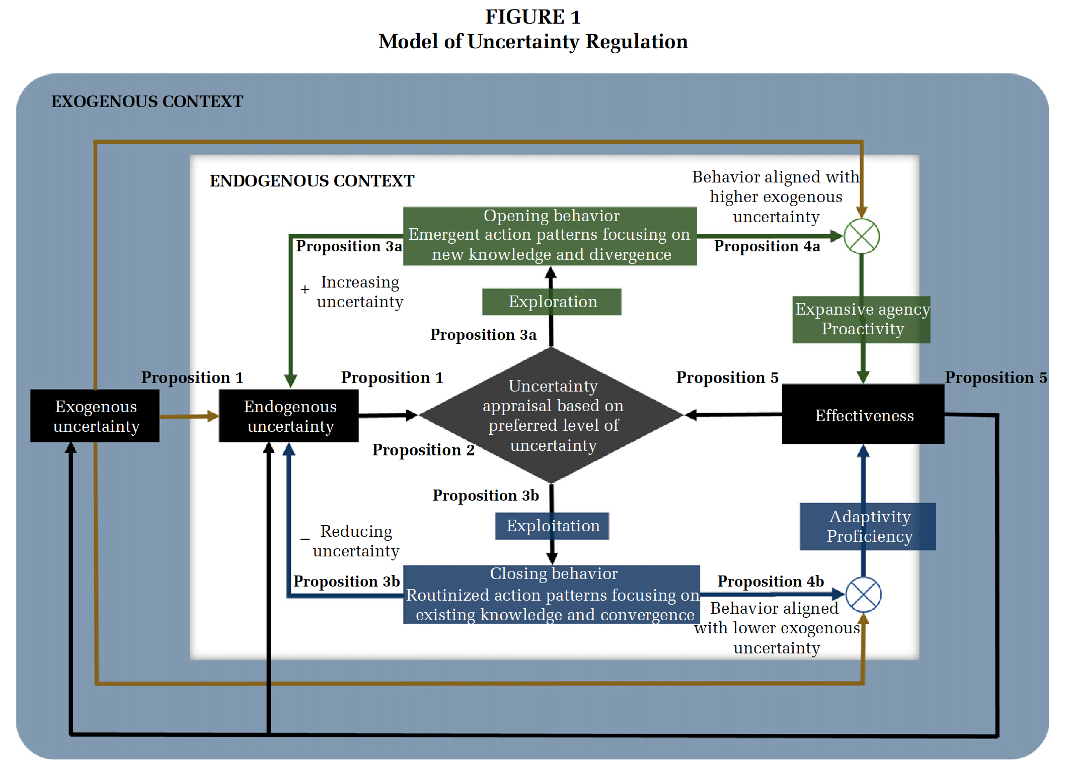
A model of uncertainty regulation (Griffin & Grote, 2020)
Individuals (and organizations) self-regulate to achieve tasks in parallel to regulating uncertainty towards a preferred level.
Uncertainty regulation happens through opening / closing behaviors, which increase / reduce uncertainty.
Performance is more effective when task uncertainty and the preferred level of uncertainty align.

Slide 9
Potential benefits of increasing uncertainty (Grote, 2015)
More uncertainty means less routinized and taken for granted action.
Admitting uncertainty supports divergent thinking and avoids premature convergence.
Uncertainty needs to be shared by all actors and eventually bounded again to reduce complexity and (re)gain control.
Two examples
Flexible rules
Speaking up

Slide 10
Uncertainty mindset (Magni et al., 2023)
Intuitive beliefs and attitudes that individuals hold regarding uncertainty
Multidimensionality & Domain–Specificity
Dimension: Threat/Opportunity & Fixed/Malleable
Domain: Life vs. Work (vs. Other)
"Wise" intervention to change uncertainty mindsets based on short exercises
Scale to measure uncertainty mindsets – examples of items
Uncertainty at work creates threats.
Uncertainty at work can stimulate my curiosity.
Even if I collect more information, I cannot change the amount of uncertainty.
When I experience uncertainty, I can do something to change it.
Threat vs. Opportunity
Fixed vs. Malleable
Notes:
Can be a very quick slide where we simply briefly define uncertainty mindset

Slide 11
Implications for leaders / leadership
Understand safety – autonomy tensions
Define the needed balance between safety and autonomy and introduce the required mechanisms
Analyze the role of uncertainty
Analyze and adapt individuals' and the organization's uncertainty mindset

