Slide 1
Safety Training in Context
Dr Colin Pilbeam
Professor of Organizational Safety
ELSE Scientific Workshop, Nice, France
13th June 2023

Slide 2
Education, Education, Education & the Importance of Context

Slide 3
What participants said….
“Something isn’t just ‘this is what it is’, and we go plunk it into an organization, and it just works beautifully every time, and it works the same way every time. There are so many other factors that have to be considered”
“H&S training without context is pointless”
“We assume people think about context – but they don’t”

Slide 4
Safety interventions - do they work?
‘The vast majority of interventions to adopt safety measures recommended by standard texts on safety, consultants and safety courses have not been adequately evaluated’
(Van der Molen et al., 2018 p.2)

Slide 5
“Practices are beliefs in action” (Drath et al., 2008)
Realist Evaluation argument:
Interventions (I) lead to outcomes (O)
“IO – Logic”
but not in all circumstances (C)….why? (M)
“CIMO – Logic”
Denyer et al., (2008) Organization Studies 29(3): 393-413

Slide 6
To change safety behaviours…
Theory | Belief | Activity | Exception
Competency | Higher skill levels enable safer working | Careful Selection. Provide Training. | Routine / mundane tasks
Trust | Other people care about me and know what I need to do. I care about others. | Listening to advice. Communicating. Team working. | Lone working. Organisational history.
Perceived Organizational Support (POS) | My employer values me | Top management commitment. Training. Giving advice | Deskilling. Redundancies. Outsourcing.

Slide 7
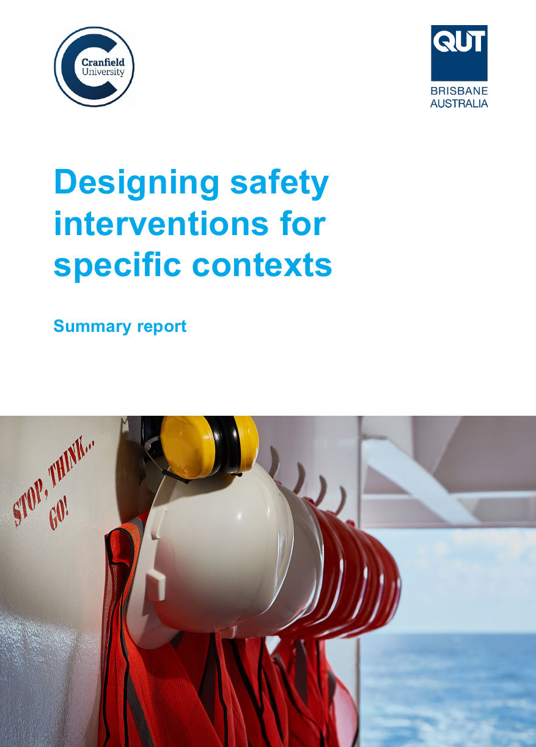
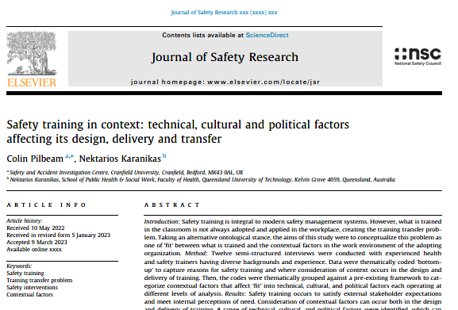
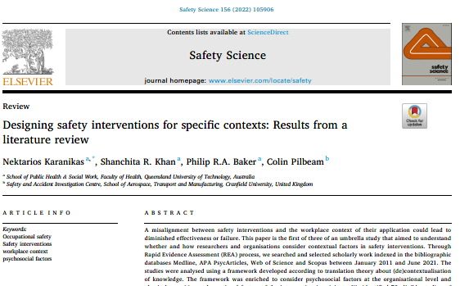
Designing Safety Interventions for Specific Contexts
A “safety intervention could be any physical artefact, process, procedure, set of skills or specialist knowledge that restores, maintains or strengthens safety”

Slide 8
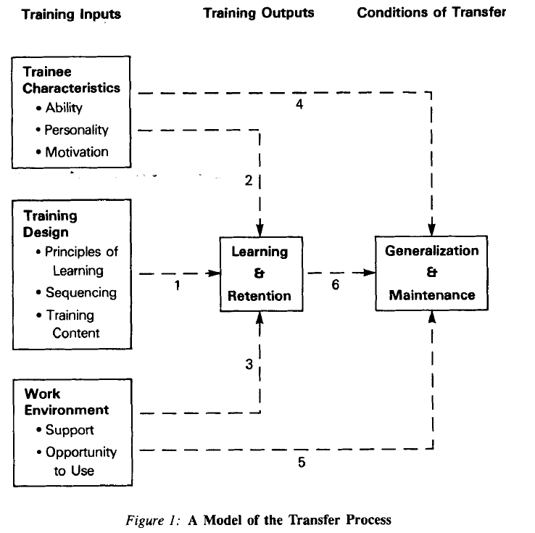
Training Transfer - Why is it difficult?
Concept of transfer:
“the extent to which knowledge and skills acquired in a training setting are generalized and maintained over a period of time in the job setting”
(Ford and Weissbein, 1997; p34)
Baldwin and Ford (1988)
What’s missing?

Slide 9
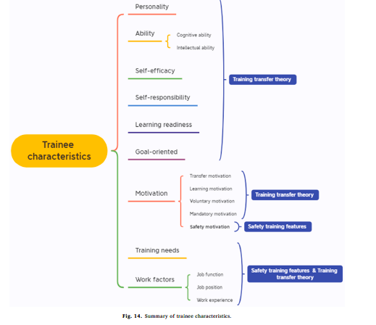
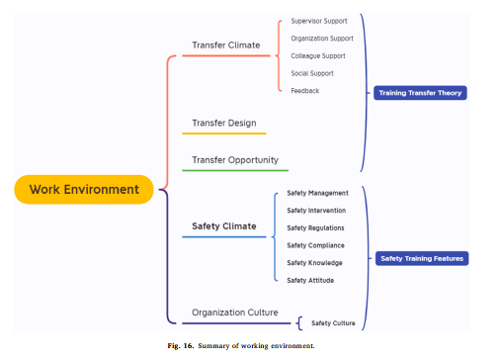
Safety Training Transfer – What do we know?
Can everyone do everything?
Do we ever evaluate training outcomes?
Chen et al (2022). Safety Science 148:

Slide 10
Safety Training Transfer – Taking a different perspective
Concept of ‘fit’:–
“the degree to which the characteristics of a practice are consistent with the (perceived) needs, objectives and structure of an adopting organisation”
(Ansari et al., 2010, p.68)
“One of the things that I find so frustrating is actually when people don’t recognize the context that they are in, and that it has an impact on what’s going on”

Slide 11
 | Technical | Cultural | Political
Individual | Competence of employees Individual attributes | Management support Reporting lines | Leadership beliefs / values
Organizational | Existing processes Size of organization | Organizational culture Voice | Group / sub-group dynamics Employee relations Competing priorities
Supra-Organizational | Regulatory context External standards Sector business model Societal challenges | National / Societal norms | Unionization Legal context Sector level sharing State orientation towards H&S

Slide 12
 | What? | How? | Why?
Individual | Competence of employees Individual attributes | Management support Reporting lines | Leadership beliefs / values
Organizational | Existing processes Size of organization | Organizational culture Voice | Group / sub-group dynamics Employee relations Competing priorities
Supra-Organizational | Regulatory context External standards Sector business model Societal challenges | National / Societal norms | Unionization Legal context Sector level sharing State orientation towards H&S

Slide 13
We do safety training because …. ?
It is an integral part of modern safety management systems
It renders staff competent to work effectively and safely
It improves safety compliance
It improves safety participation
Others expect it … “we have done everything we can”
It is easy (relatively)
It can be demonstrated

Slide 14
But …
Does it fix the problem?
Is it effective?
Is it accessible to all?
“Training interventions do not [always] yield tangible benefits and may sometimes simply reduce to wasted resources”
(Albert and Routh, 2021)
e.g.
Demographics
Disability
Psycho-social factors

Slide 15
The Spirit of the Age …. To be authentic
Defined as
– Reliable, trustworthy, genuine, of known provenance
Aim of Safety Training: to develop Translation competence
Translation competence
– “the ability to translate practices and ideas between organizational contexts in ways that increase the probability of achieving organizational ends”
(Røvik, 2016 p.299)

Slide 16
Questions / Comments / Discussion

Slide 17
Safer Governance of Complex Systems - Learning from failures
This international multi-sector survey …
Join Join Today !
And prevent future safety failures

Slide 18
Relevant references
Karanikas, Khan, Baker and Pilbeam (2022). Designing safety interventions for specific contexts: results from a literature review. Safety Science. https://doi.org/10.1016/j.ssci.2022.105906
Pilbeam and Karanikas (2023). Safety training in context: technical, cultural and political factors affecting its design, delivery and transfer. Journal of Safety Research. https://doi.org/10.1016/j.jsr.2023.03.004
Pilbeam and Karanikas. Insights from translation theory on the implementation of safety interventions across different organizational contexts. Safety Science (under review)
Ansari, Fiss, Zajac (2010). Made to fit: how practices vary as they diffuse. Academy of Management Review 35: 67-92.
Baldwin and Ford (1988). Transfer of training: a review and directions for future research. Personnel Psychology 41:63-105.
Casey, Turner, Hu, Bancroft (2021). Making safety training stickier: A richer model of safety training engagement and transfer. Journal of Safety Research 78: 303-313.
Denyer et al., (2008). Organization Studies 29(3): 393-413.
Ford and Weissbein (1997). Performance Improvement Quarterly 10:22-41.
Pilbeam et al. (2019). Designing safer working interventions through a literature review using a mechanisms-based approach. Safety Science 120:352-361
Røvik (2016). Knowledge transfer as translation: review and elements of an instrumental theory. International Journal of Management Reviews 18:290-310.

Slide 19
Further information
www.linkedin.com/in/colinpilbeam
colin.pilbeam@cranfield.ac.uk

